Slide 1
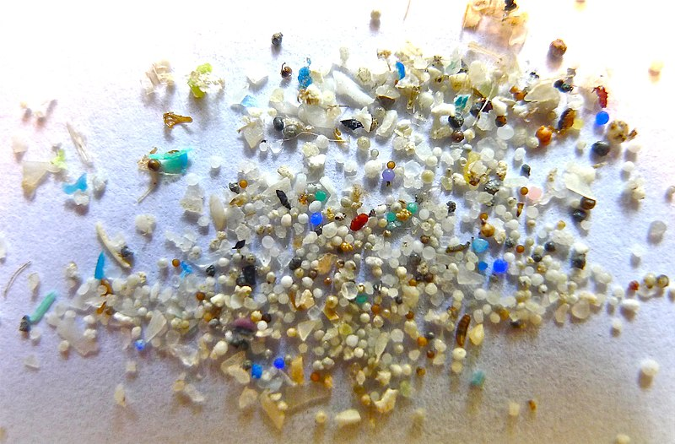
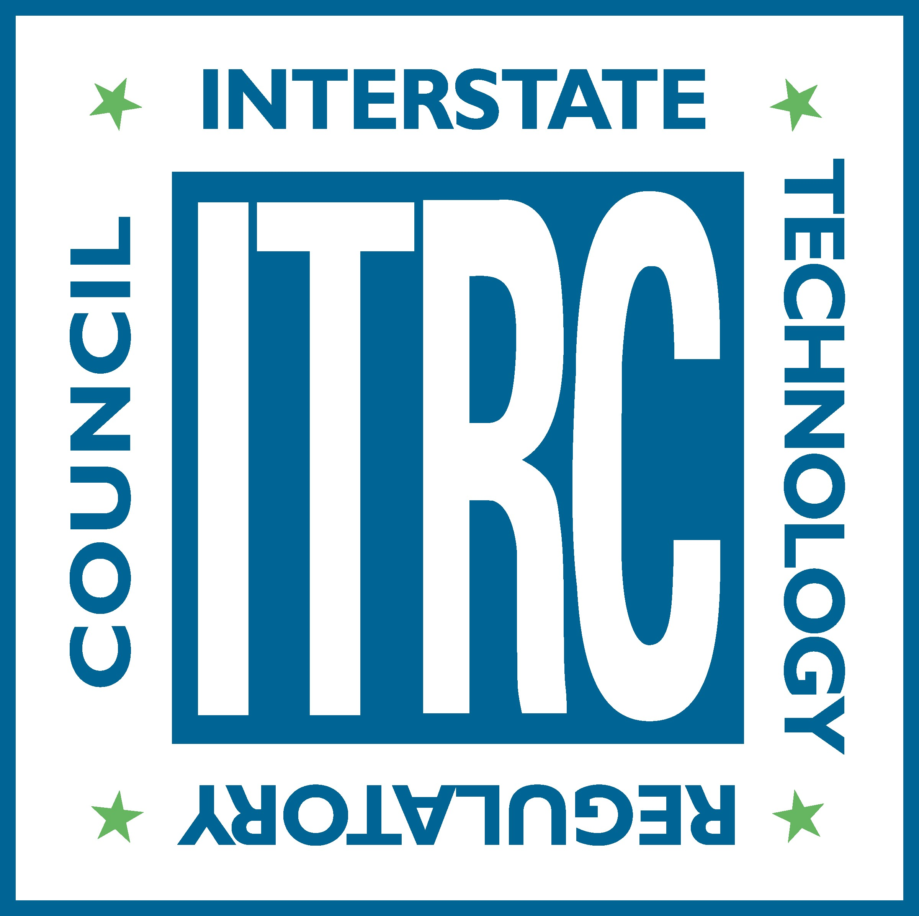
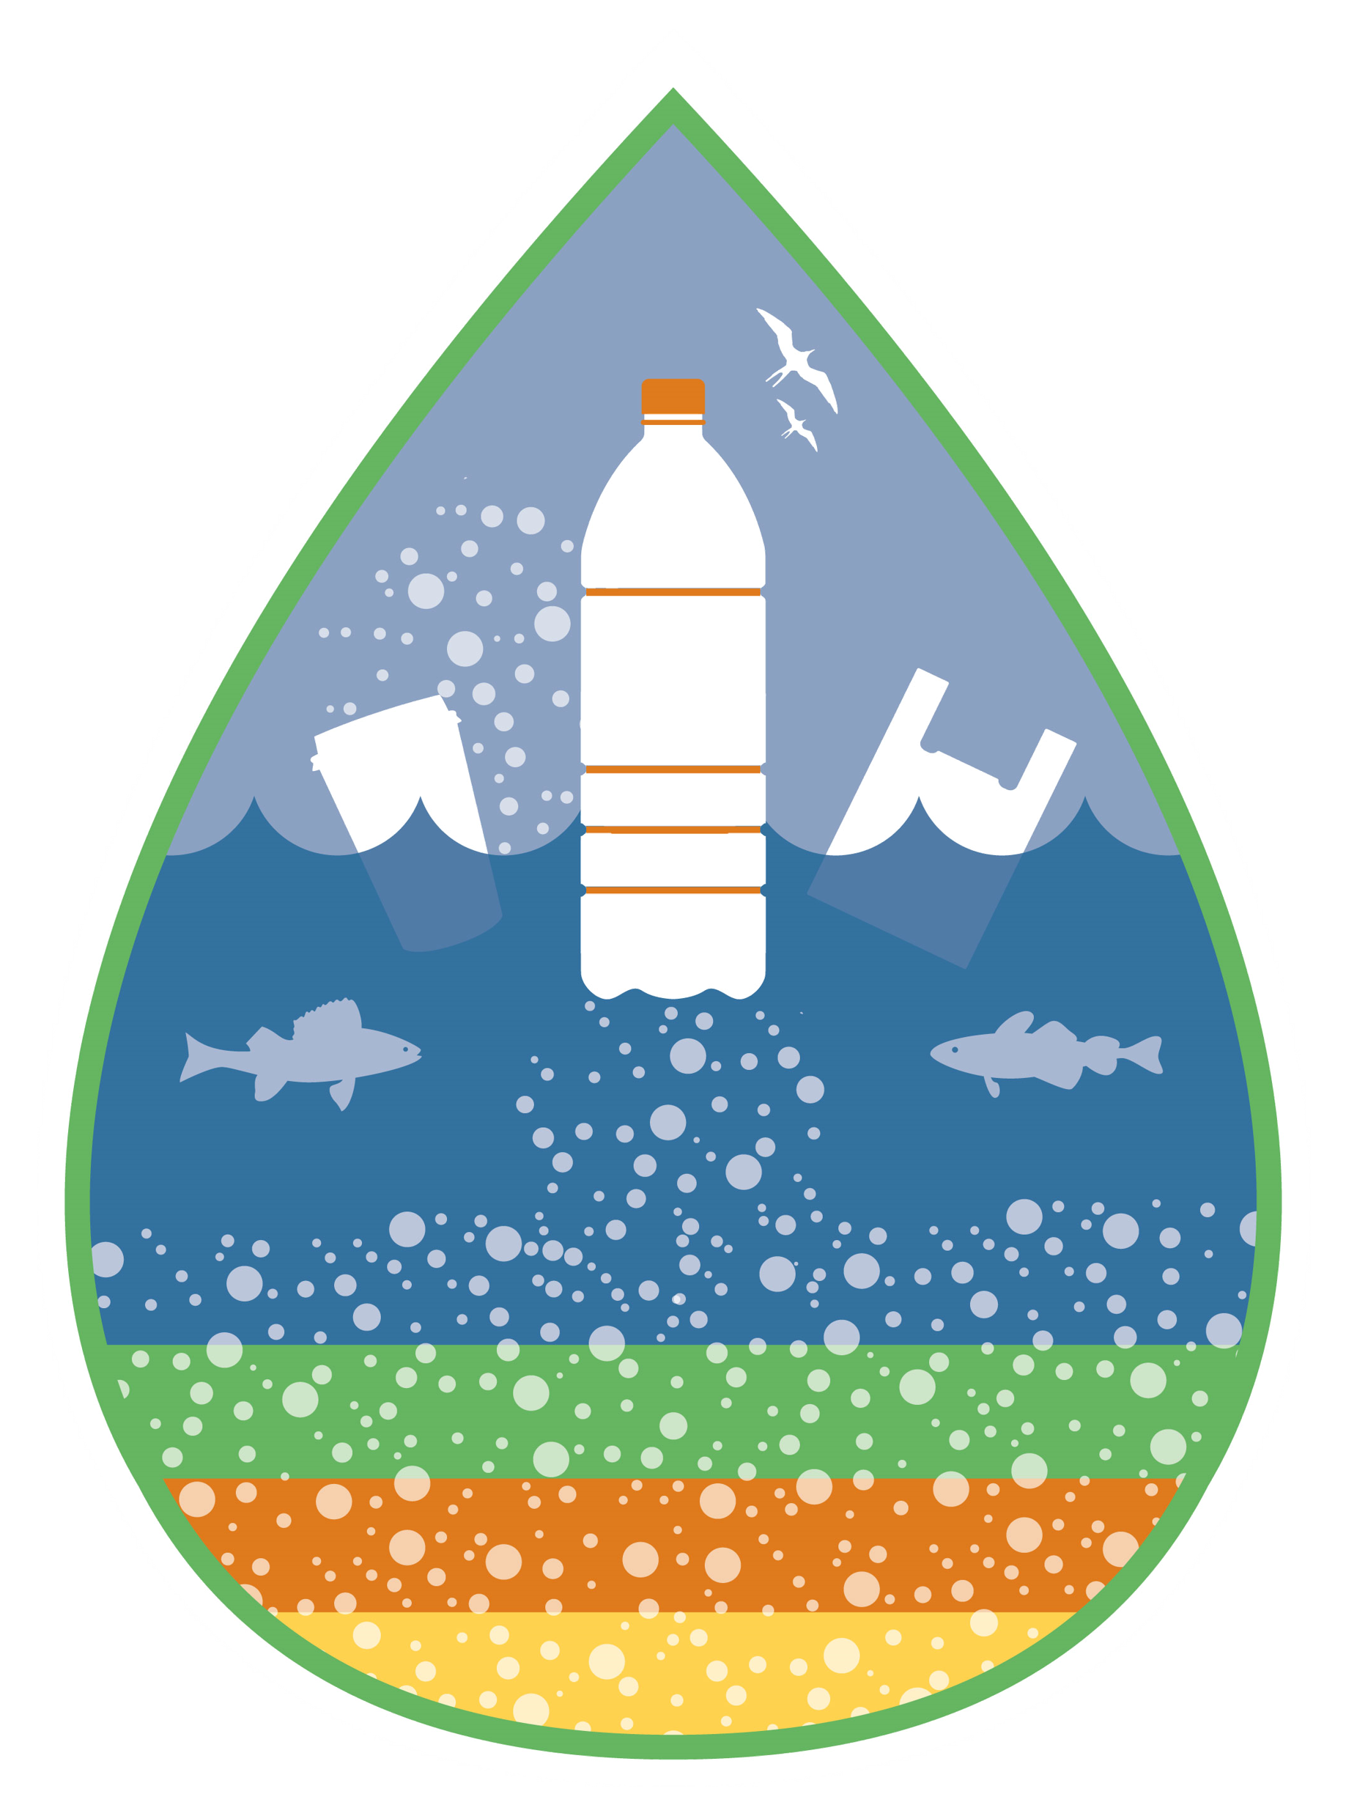
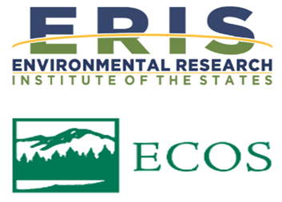
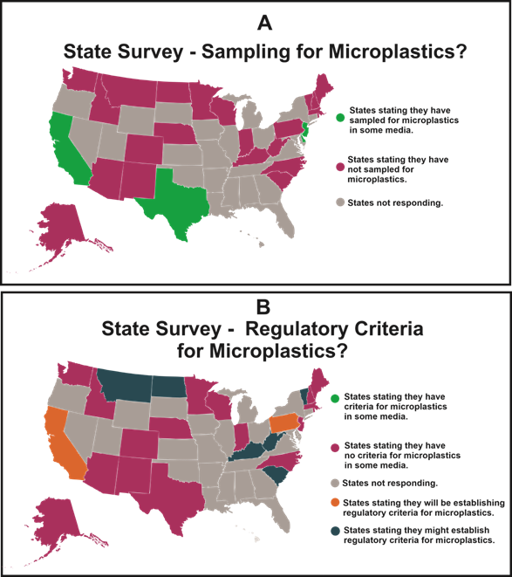
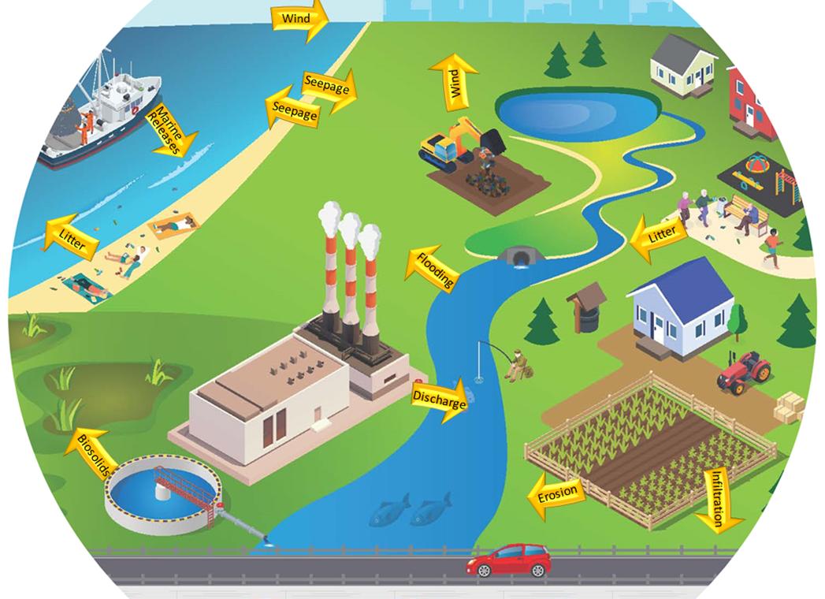
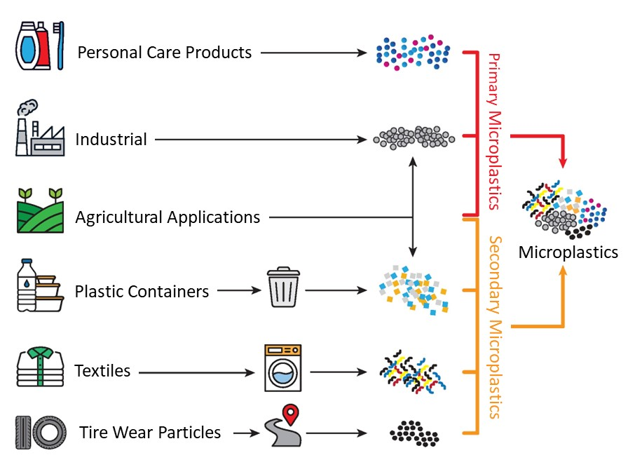
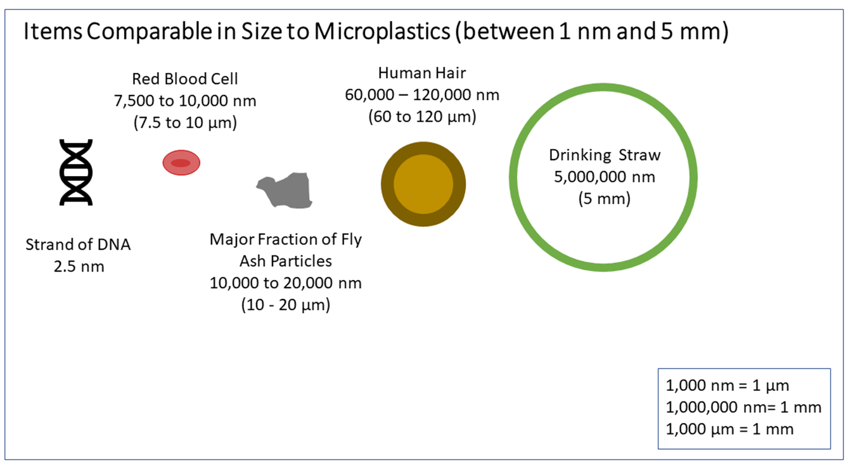
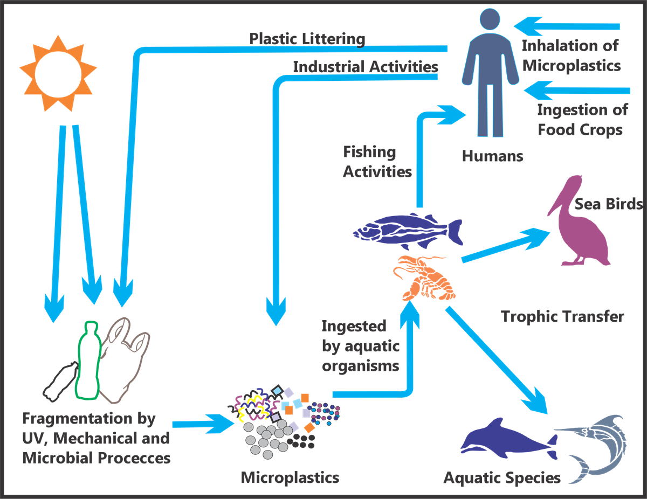
Introducing the ITRC Microplastics Guidance
MP-1-21 07/2024
Who Is ITRC?
What’s in the Guidance?
Where Can I Find it?
The Interstate Technology and Regulatory Council (ITRC) is a state-led environmental coalition working to create innovative solutions and best management practices (BMPs) for the U.S. environmental sector. ITRC represents all 50 states with membership from state, federal, tribal, and international agencies, as well as members from academia, the private sector, and the public. ITRC produces guidance documents and trainings that broaden and deepen technical knowledge and expedites quality regulatory decision making while protecting human health and the environment. ITRC is a program of the Environmental Research Institute of the States (ERIS) and managed by the Environmental Council of the States (ECOS). itrcweb.org
Section 1 - Introduces the topic of microplastics
Section 2 - Information on how microplastics move and where they can be found in the environment
Section 3 - Sampling and analysis considerations, including a Microplastics Sampling Method Selection Tool that allows users to filter identified techniques by media and particle size range of interest
Section 4 - Information on human health and environmental effects
Section 5 - Summary of current laws and regulations
Section 6 - Technologies for abating and mitigating microplastics
Section 7 - Current data gaps and recommendations for future research and regulatory actions
https://mp-1.itrcweb.org/
What’s Next?
Online trainings on the guidance document are provided quarterly through USEPA CLU-IN platform (https://www.clu-in.org/conf/itrc/Microplastics/). ITRC developed an outreach toolkit and encourages its use to communicate microplastics issues to decision-makers and members of the public. The toolkit is available online.
What Are Microplastics?
Microplastics are particles that are greater than 1 nanometer (nm) and less than 5 millimeters (mm) in their longest dimension and comprised of solid polymeric materials to which chemical additives or other substances may have been added. Polymers that are derived in nature that have not been chemically modified (other than by hydrolysis) are excluded. This definition includes nanoplastics, which range from 1 nm to 1,000 nm.
Microplastics in the environment are classified as primary or secondary. Primary microplastics are generated by plastic pellet production facilities and manufacturing facilities as a component of industrial or commercial products. Secondary microplastics are created through physical, chemical, and biological alteration/degradation of larger pieces of plastic.
State survey data current as of June 2021
*
*enlarged to show detail
Why Should I Care?
Microplastics are ubiquitous in the environment. They have been found in the air we breathe, the water we drink, and the food we consume. Microplastics pose a potential risk to humans and wildlife through exposure to the chemicals in plastic and through physical impact. In response to this emerging environmental issue, the ITRC created a Microplastics Team, comprising experts from city, state, tribal, and federal agencies, as well as the private sector and academia, to develop guidance that provides an understanding of microplastics and the state of the applied science.
Movement of microplastics in surface waters.
All figures on this poster are from the ITRC guidance document. ITRC has permission/copyright release forms from each of the creators of the images used. The views expressed in this presentation are those of the ITRC Microplastics Team and do not necessarily represent the views or policies of the USEPA or other associated government agencies.
Examples of how some primary and secondary microplastics sources could result in microplastics entering the food chain at various trophic levels, potentially resulting in environmental and human exposures.
Examples of primary and secondary microplastic sources.

