Slide 1
Microplastics (MP)
This presentation has been developed by the Interstate Technology and Regulatory Council (ITRC) Microplastics Outreach Team. You may modify the slide deck as appropriate for your audience. We ask that you acknowledge the products of ITRC in your presentation. Thank you!
ITRC is a state-led coalition comprised of state & federal governments, stakeholders, and industry members. ITRC is funded through federal grants/industry membership fees. ITRC operates under a consensus-driven process to develop guidance documents & products. https://itrcweb.org/guidance
Notes:
Documents, training curricula, and other print or electronic materials created by the Interstate Technology and Regulatory Council (“ITRC”; such materials are referred to as “ITRC Materials”) are the property of ITRC under United States intellectual property law and international conventions. ITRC Materials, such as information from ITRC documents, ITRC training slides, and graphics from documents or other print or electronic materials, may not be used for profit. ITRC Materials can be used for educational and training purposes with the conditions outlined below. If you have a question regarding proper use of ITRC Materials, please contact the ITRC Director at 202-266-4933 or itrc@itrcweb.org.

Slide 2
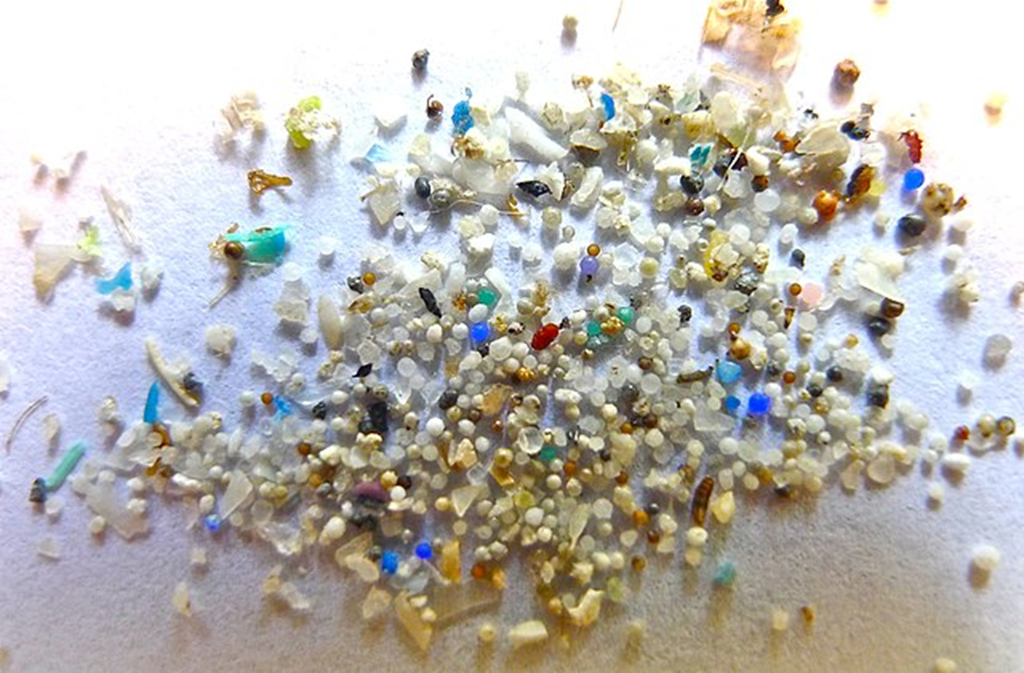
What’s the Big Deal with Small Plastic?
ITRC is a state-led coalition comprised of state & federal governments, stakeholders, and industry members. ITRC is funded through federal grants/industry membership fees. ITRC operates under a consensus-driven process to develop guidance documents & products. https://itrcweb.org/guidance
Notes:
Small plastics, termed microplastics (greater than 1 nanometer through 5 millimeters), are an area of concern due to their known and unknown impacts on the environment and human health.

Slide 3
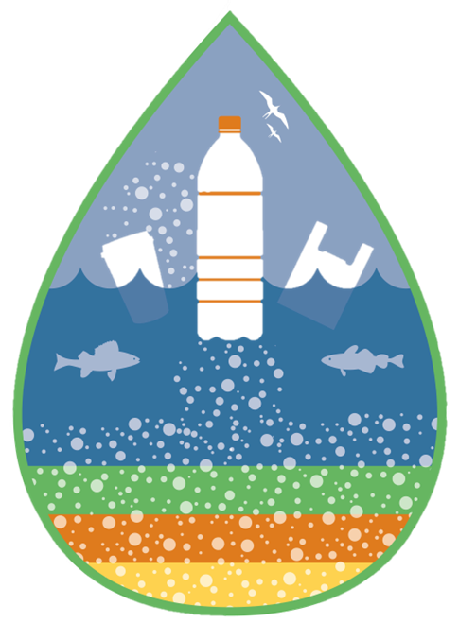
Microplastics (MP)
What are they?
Plastic particles ranging in size from 1 nanometer to 5 millimeters that contain chemical and/or other additives
Where do they come from?
Consumer products (primary and/or direct point source) and/or the breakdown of larger plastics (secondary and/or nondirect point source)
Where are they found?
Everywhere. MP have been found in drinking water, the human body, food, air, soil, and in water, to name a few places
ITRC is a state-led coalition comprised of state & federal governments, stakeholders, and industry members. ITRC is funded through federal grants/industry membership fees. ITRC operates under a consensus-driven process to develop guidance documents & products. https://itrcweb.org/guidance
Notes:
Please note that the acronym “MP” will be used throughout the presentation as a short-hand version of “microplastics.” This presentation will address what microplastics are and briefly explore where they come from and where they are found.
ITRC’s definition of MPs was influenced by other agencies.

Slide 4
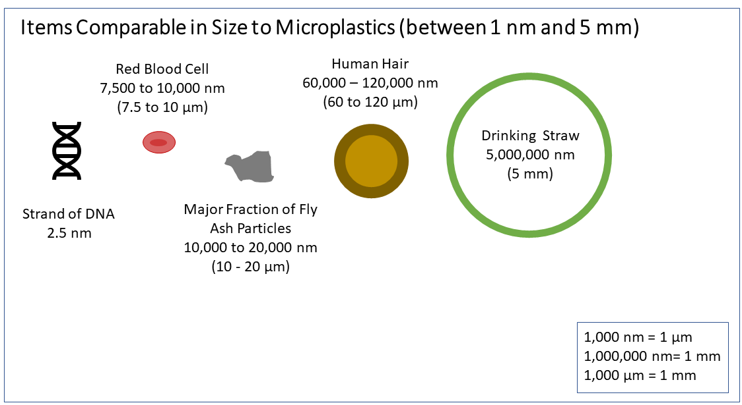
Microplastic Size
1,000 nm = 1µm
1,000,000 nm = 1 mm
1,000 µm = 1 mm
ITRC MP Figure 1-2
Source: V. Hanley
ITRC is a state-led coalition comprised of state & federal governments, stakeholders, and industry members. ITRC is funded through federal grants/industry membership fees. ITRC operates under a consensus-driven process to develop guidance documents & products. https://itrcweb.org/guidance
Notes:
As mentioned in the definition, MPs can range from 1 nm up to 5 mm. This is a figure from Chapter 1 of the ITRC Microplastics Guidance document. The largest MP particle size is smaller than 5 mm, which is the approximate diameter of a drinking straw. The smallest MP particle size is 1 nm, which is smaller than a strand of DNA.

Slide 5
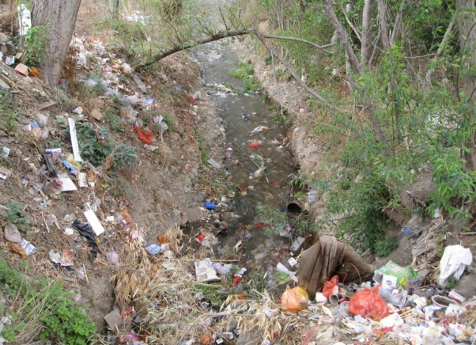
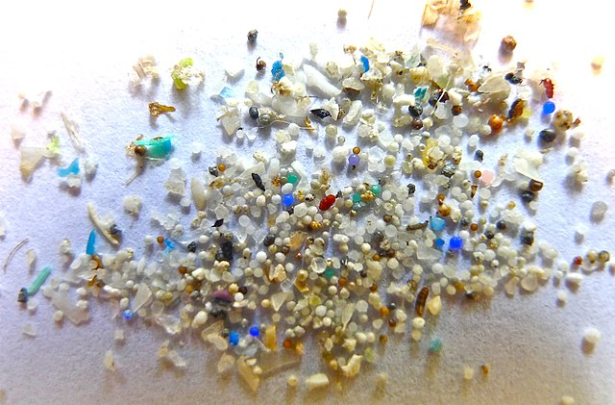
What We Know about Microplastics
Ubiquitous in the environment
Accumulate & persist in the environment
Can contain harmful chemical contaminants & additives
Consumed by humans and other organisms
Cause adverse health impacts in organisms
Source Top: Flickr, Global Water Forum
Source Bottom: Oregon State University, CC-BY-SA-2.0
ITRC is a state-led coalition comprised of state & federal governments, stakeholders, and industry members. ITRC is funded through federal grants/industry membership fees. ITRC operates under a consensus-driven process to develop guidance documents & products. https://itrcweb.org/guidance
Notes:
What do we know about microplastics?
MPs are ubiquitous in the environment; they are found in surface waters, drinking water, air, and even in the food humans consume.
MPs accumulate and persist long term in the environment, and they can move long distances in the environment.
MPs can also contain harmful chemical contaminants and additives that can move along with them in the environment.
Because of their small size, MPs can be consumed by humans, and some other organisms can confuse them with food, depending on the MP’s shape and color.
MPs can cause adverse health impacts for organisms that are exposed to them.
Image at: https://www.flickr.com/photos/globalwaterforum/7581251632/in/photolist-cxVTZ3-6es7gi-5yARo6-8MmKW9-i22mQ-bhrsMv-gzCvs1-2cbAr8R-9DbWoP-8NYREx-cG6yu3-7Jr6QV-84cioa-4pXCbh-6xLXtE-fS7Auk-onki-nyMZ6S-5csu7z-8hf5dX-8hf2a4-4pTwY6-zF1Km4-4zUVXJ-dDip1m-7Jr6MR-4Gwx6C-Dz2yM-zd7jiR-fbLzuP-7Jv2q1-7Jr5Pg-7Jr6EP-8fjwSd-8T5pDb-7Jr6VR-8hfaAM-8hfaqp-8icddY-iqiGK-27G8CJ9-aZvRBp-3ZprNQ-nc5cnu-5rHu4g-4kSSpX-877J9L-6Aepuq-8hyEf8-7Jr734/
https://commons.wikimedia.org/wiki/File:Microplastic.jpg

Slide 6
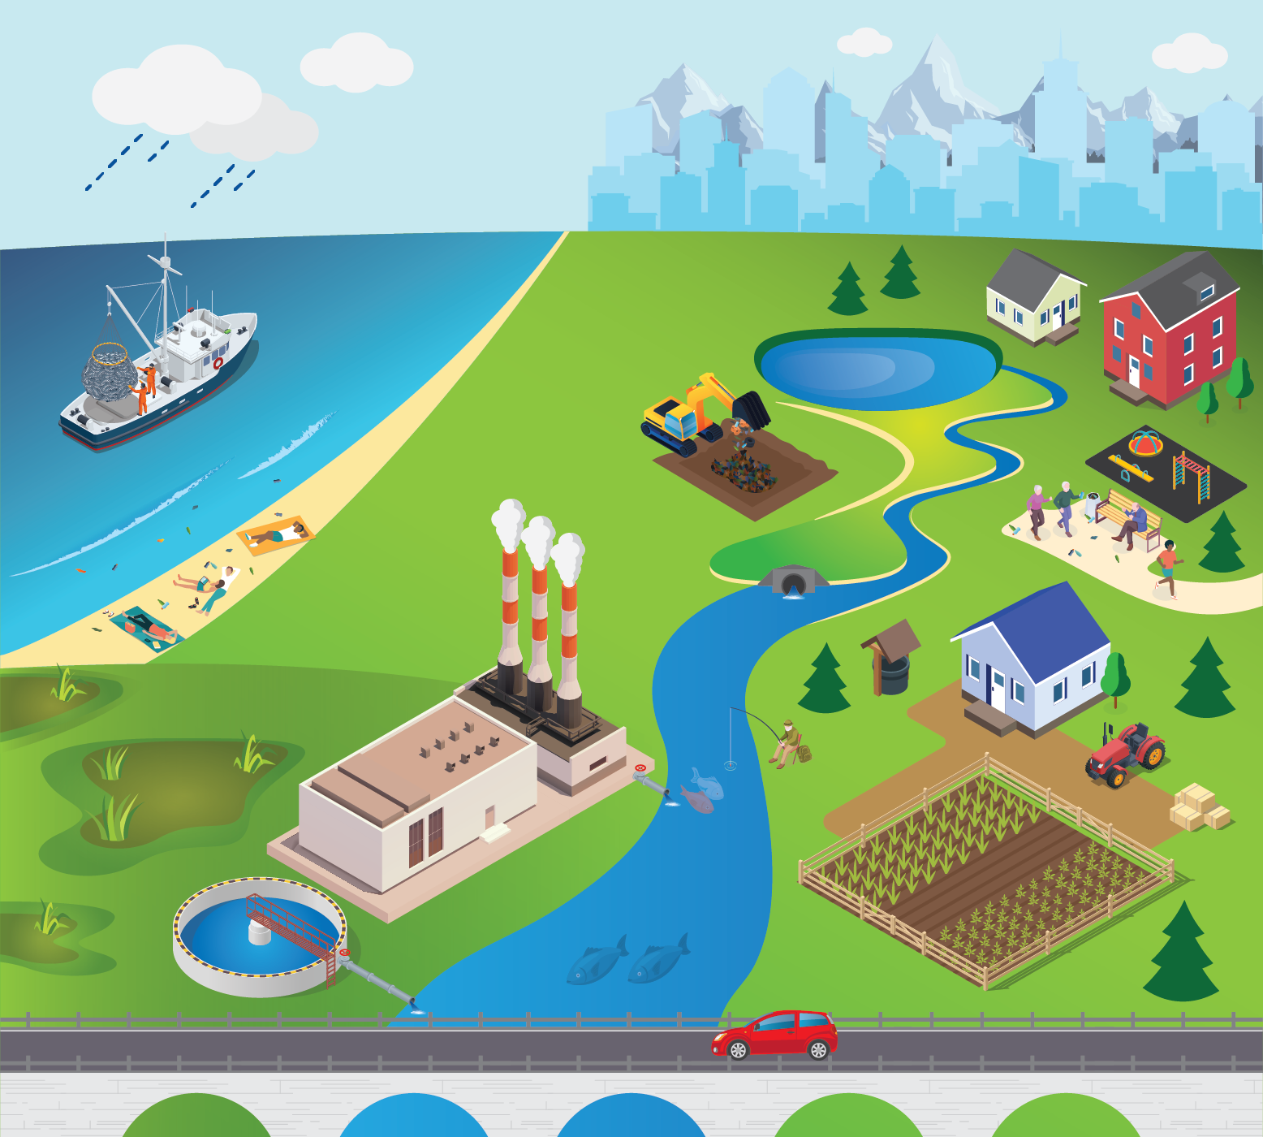
Where Are Microplastics Found?
ITRC MP conceptual site model
Multifunctional tool
Overview information
Document navigation
ITRC is a state-led coalition comprised of state & federal governments, stakeholders, and industry members. ITRC is funded through federal grants/industry membership fees. ITRC operates under a consensus-driven process to develop guidance documents & products. https://itrcweb.org/guidance
Notes:
This illustration is the conceptual site model (or CSM) for microplastics used in the online ITRC guidance document. It’s an interactive figure with popups that provide information about various sources and mechanisms of microplastic transport. In this set of slides, we’ll use the CSM as we talk through examples. You can also use the interactive CSM to navigate through the online document (https://mp-1.itrcweb.org/)

Slide 7
Conceptual Site Model - Point Sources
Marine point sources:
Materials lost or discarded from vessels
Stormwater outfalls
Industrial smokestacks
Wastewater outfalls
ITRC is a state-led coalition comprised of state & federal governments, stakeholders, and industry members. ITRC is funded through federal grants/industry membership fees. ITRC operates under a consensus-driven process to develop guidance documents & products. https://itrcweb.org/guidance
Notes:
Here we have some examples of point sources of microplastics. Point sources are discrete conveyances such as stormwater or wastewater outfalls, smokestacks, industrial releases of nurdles (primary microplastics used in plastic manufacturing), or fishing areas (derelict fishing nets). There can also be marine point sources such as oceangoing vessels that may have lost or discarded materials overboard.

Slide 8
Conceptual Site Model - Nonpoint Sources
Microplastics transported through atmosphere and deposited far away from the source
Microplastics present in household products such as toothpaste or facial cleaners. Microplastics generated through household activities such as laundering of clothing
(Macro)plastic trash washes into the ocean, then breaks down into smaller pieces, eventually becoming microplastics
Microplastics present in agricultural lands due to direct application of fertilizer pellets, biosolids from wastewater treatment plants, or breakdown of plastic sheeting
Microplastics generated through typical tire wear and breakdown of roadway materials
ITRC is a state-led coalition comprised of state & federal governments, stakeholders, and industry members. ITRC is funded through federal grants/industry membership fees. ITRC operates under a consensus-driven process to develop guidance documents & products. https://itrcweb.org/guidance
Notes:
Due to the ubiquitous nature of microplastics, nonpoint sources are especially problematic. Nonpoint sources of microplastic pollution occur where there are broad areas or many sources that distribute microplastics into the environment. Microplastics can originate in one area and be transported to another by water or air. Beaches are an example of nonpoint sources. Litter may be spread along a beach and wash up or be transported by wind to other areas. Residential neighborhoods can be nonpoint sources as household products are used and discarded. Agricultural lands are another example of a nonpoint source. Microplastics may originate from fertilizer pellets, wastewater treatment plant biosolids used as fertilizers, or even home gardening materials, such as plastic sheeting, containers, and gloves. Roadways also are nonpoint sources, where tires are worn down and generate tire wear particles.

Slide 9
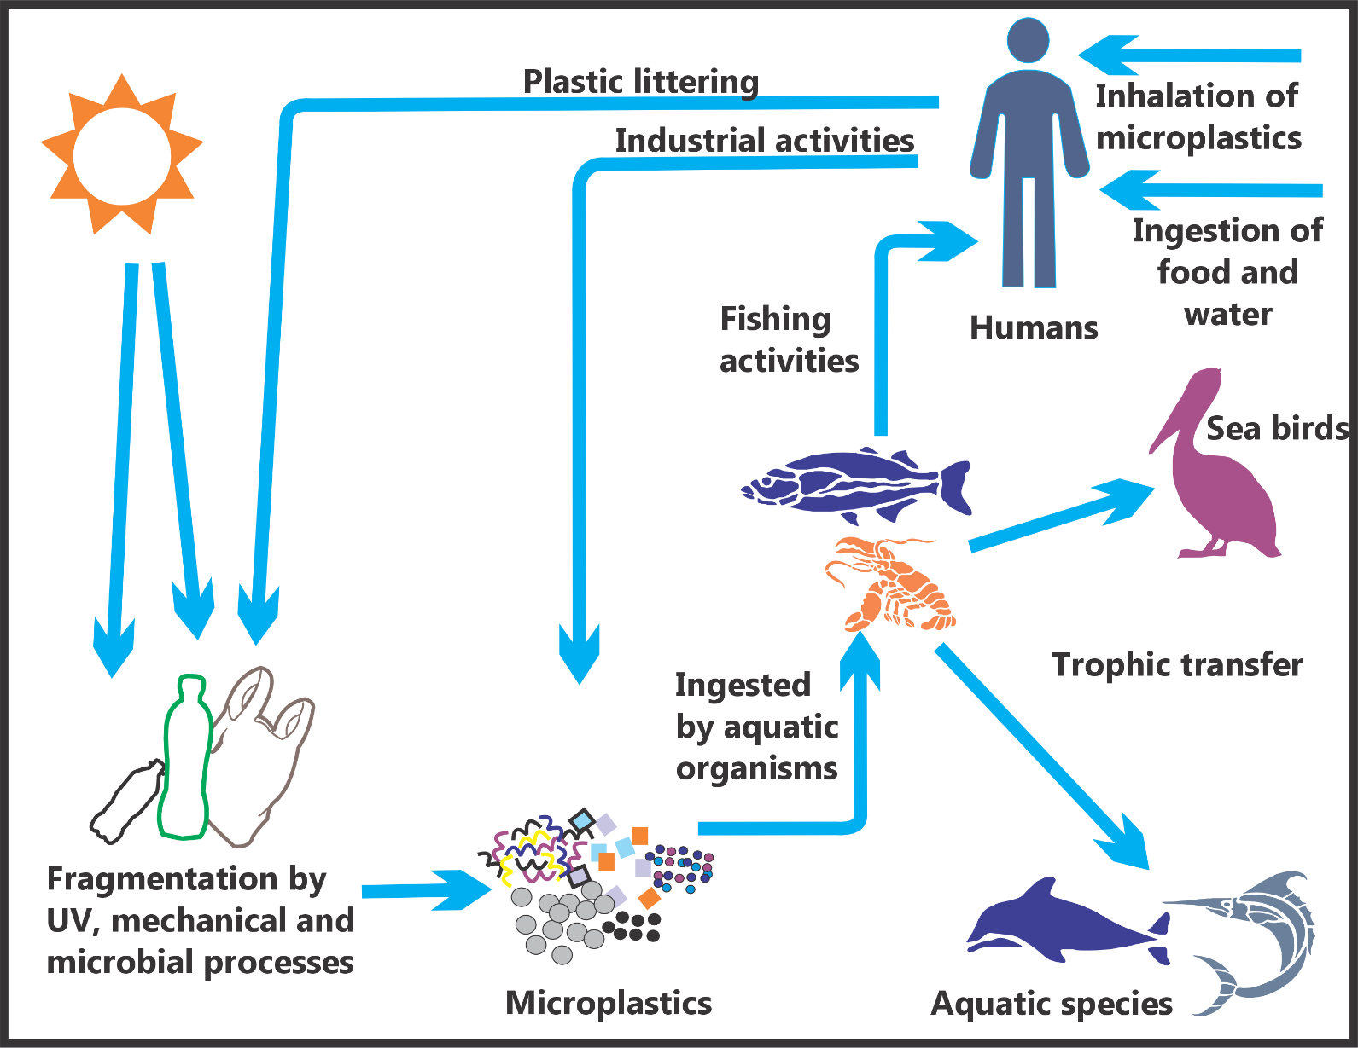
Why Should We care?
ITRC MP Figure 4-2
ITRC is a state-led coalition comprised of state & federal governments, stakeholders, and industry members. ITRC is funded through federal grants/industry membership fees. ITRC operates under a consensus-driven process to develop guidance documents & products. https://itrcweb.org/guidance
Notes:
Every habitat and organism is exposed to MPs. This diagram generalizes how MPs in the environment expose animals and humans. Humans can be exposed through inhalation and ingestion of contaminated water or food, both through trophic transfer (eating animals that have eaten MPs) or ingestion of crops grown in soils containing microplastics. MPs have been found in human lungs, blood, placenta, breast milk, and heart tissue. However, the impacts that MPs have on the human body are unknown. MPs have been shown to have adverse impacts to animals, though determining toxicity to organisms can be difficult.

Slide 10
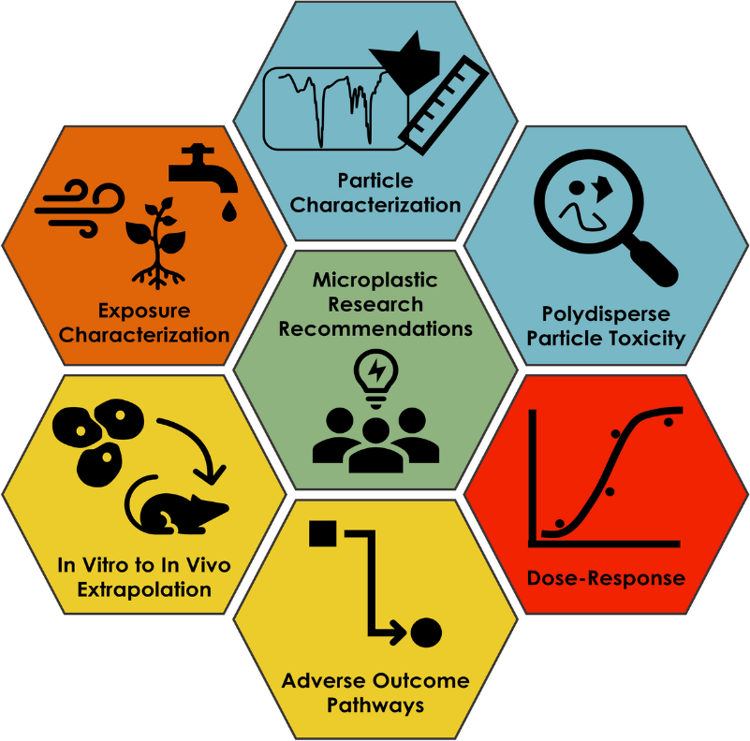
Challenges in Toxicity Research
Exposure ≠ Adverse health effect
Numerous nonhuman mammalian studies available but methodologies vary
Uncertainties due to study design, exposure concentration, data quality, reporting, data gaps
Not enough information to establish toxicity criteria to use in environmental or human health risk assessment
Source: Thornton Hampton et al. 2022
ITRC is a state-led coalition comprised of state & federal governments, stakeholders, and industry members. ITRC is funded through federal grants/industry membership fees. ITRC operates under a consensus-driven process to develop guidance documents & products. https://itrcweb.org/guidance
Notes:
There is a lot of variation in quality and usability in the MP toxicity information available. Microplastics toxicity can be caused by both physical and chemical properties and the pathogens that may be carried with them. Exposure does NOT equal effects. Having biomarker responses (e.g., presence in blood, urine, or tissues) may only indicate that exposure has occurred. It does not mean that every response is automatically an adverse health effect.
Numerous nonhuman mammalian studies are available, but usability varies in study design, exposure concentration, data quality, and reporting, which leads to significant data gaps.
Currently, there is not enough information to establish toxicity criteria to use in environmental or human health risk assessments.

Slide 11
What Is Being Done?
Local actions
State actions
Federal actions
International actions
ITRC is a state-led coalition comprised of state & federal governments, stakeholders, and industry members. ITRC is funded through federal grants/industry membership fees. ITRC operates under a consensus-driven process to develop guidance documents & products. https://itrcweb.org/guidance
Notes:
What are governing bodies doing to reduce microplastics? Some actions at various levels of government have established or are establishing mechanisms to reduce microplastics in the environment.

Slide 12
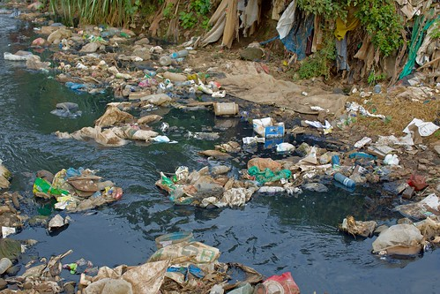
Local Actions
Single-Use Plastic Bans
Photo credit: Rob Barnes, Grid Arendal
ITRC is a state-led coalition comprised of state & federal governments, stakeholders, and industry members. ITRC is funded through federal grants/industry membership fees. ITRC operates under a consensus-driven process to develop guidance documents & products. https://itrcweb.org/guidance
Notes:
One of the most common local efforts to reduce plastics and thus, microplastics, is a city-level plastic bag ban. San Francisco was the first city to implement a plastic bag ban in 2007. Currently (as of April 2024), California, Colorado, Connecticut, Delaware, Hawaii, Maine, New Jersey, New York, Rhode Island, Vermont, and Washington now have state-wide bans. Numerous cities have now implemented bans in the following states: Alaska, Florida, Illinois, Iowa, Massachusetts, Maryland, New Mexico, North Carolina, Oregon, South Carolina, and Texas. These bans prohibit plastic bags from being used for free. Some cities have banned plastic bags entirely; others have implemented a fee for their use.

Slide 13
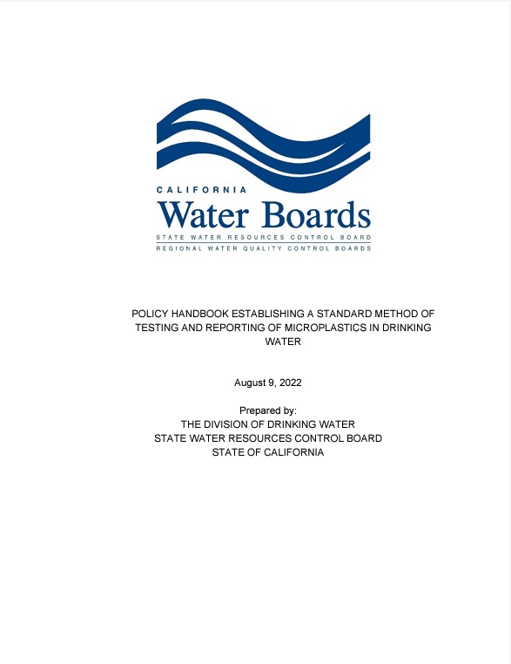
State Actions California Safe Drinking Water Act: Microplastics
Adopt a definition of microplastics in drinking water
Adopt a standard methodology to test drinking water for microplastics
Establish requirements for four years of testing and reporting microplastics in water
CA Health and Safety Code 116376
ITRC is a state-led coalition comprised of state & federal governments, stakeholders, and industry members. ITRC is funded through federal grants/industry membership fees. ITRC operates under a consensus-driven process to develop guidance documents & products. https://itrcweb.org/guidance
Notes:
California’s full approach to addressing microplastics is included in their online documents. In 2018 the state passed a pair of bills: Senate Bill 1422 and Senate Bill 1263, which have since been incorporated into state law.
SB 1422 has been added to the California Safe Drinking Water Act. It is focused on drinking water and includes a definition of microplastics and a standard method applicable to testing for microplastics in drinking water. It also includes a 4-year drinking water testing and reporting requirement and public disclosure of the results. A policy handbook was issued in September 2022 to help implement this 4-year testing effort. The first two years of monitoring results will be followed by 6 months of evaluation, which will include figuring out whether more sophisticated test methods are needed.

Slide 14
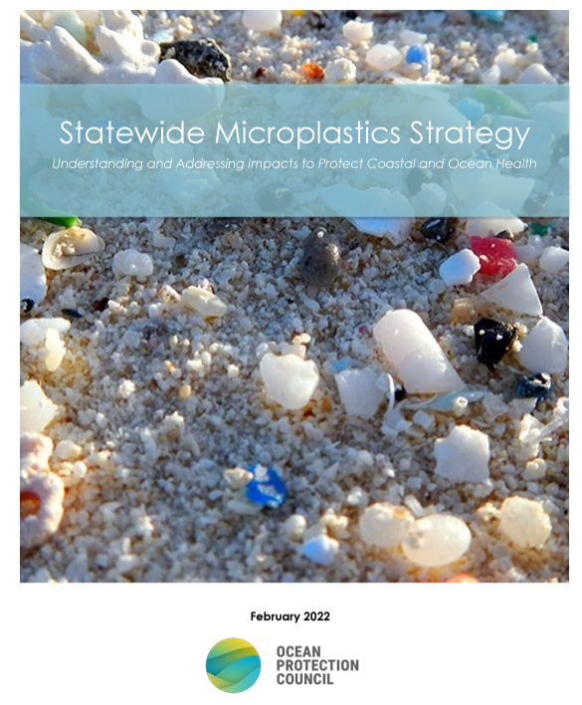
State Actions Statewide Microplastics Strategy - 2 Track Approach
Track 1: Solutions
Pollution prevention
Pathway interventions
Outreach & education
Track 2: Science to inform future action
Monitoring
Risk thresholds & assessments
Sources & pathways prioritization
Evaluating new solutions
CA Public Resources Code, Division 26.5, Chapter 3.2
ITRC is a state-led coalition comprised of state & federal governments, stakeholders, and industry members. ITRC is funded through federal grants/industry membership fees. ITRC operates under a consensus-driven process to develop guidance documents & products. https://itrcweb.org/guidance
Notes:
SB 1263 was adopted into the California Public Resources Code and resulted in a two-track approach to understanding and addressing microplastics in a Statewide Microplastics Strategy. This strategy was issued in February 2022 and provides a multiyear roadmap identifying specific actions that the state plans to take.

Slide 15
Federal Actions Save Our Seas 2.0 Act (Public Law 116-224)
Three main goals of Act
Combat marine debris
Enhance global engagement
Improve domestic infrastructure
Source: https://www.grida.no/resources/6912 (Maphoto/Riccardo Pravettoni)
ITRC is a state-led coalition comprised of state & federal governments, stakeholders, and industry members. ITRC is funded through federal grants/industry membership fees. ITRC operates under a consensus-driven process to develop guidance documents & products. https://itrcweb.org/guidance
Notes:
Save our Seas 2.0 Act is a bipartisan approved piece of legislation that was passed into law December 18, 2020. It expands on the Save our Seas Act enacted in 2018, which focused on outreach regarding marine debris and responses after natural disasters. The Save our Seas 2.0 Act addresses plastic waste and its role in ocean pollution. Specifically, the act contains three titles to (1) combat marine debris, (2) enhance global engagement to combat marine debris, and (3) improve domestic infrastructure to prevent marine debris. The U.S. Environmental Protection Agency is responsible for addressing nine sections under these titles.

Slide 16
International Actions: European Union
European Chemicals Agency proposes restriction on intentionally added microplastics to consumer and professional products
Approved by European Parliament
and the Council
2019
2023
ITRC is a state-led coalition comprised of state & federal governments, stakeholders, and industry members. ITRC is funded through federal grants/industry membership fees. ITRC operates under a consensus-driven process to develop guidance documents & products. https://itrcweb.org/guidance
Notes:
Here is a brief overview of important steps that are being taken in the EU to restrict MP. In 2019, the European Chemicals Agency proposed a restriction on intentionally added MP to consumer and professional products. In 2020, that agency’s Committee for Risk Assessment supported the proposal and recommended removing a lower limit on the size of MP added to products. In April 2023, the Registration, Evaluation, Authorization, and Restriction of Chemicals Committee voted in favor of the proposal, which was approved in Sept 2023 by the European Parliament (https://ec.europa.eu/commission/presscorner/detail/en/ip_23_4581).
REACH- Registration, Evaluation, Authorisation, and Restriction of Chemicals

Slide 17
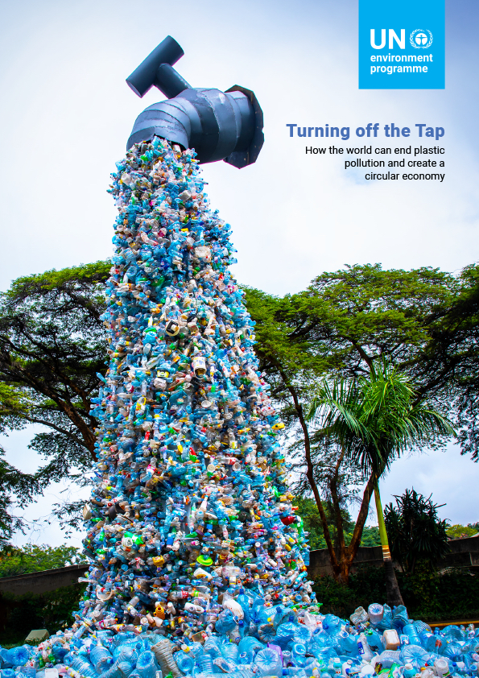
International Actions- UN Plastics Report
Purpose of report:
Designed for decision-makers & stakeholders
Explains the changes surrounding plastics
Market shifts
Policies
Goal is to end plastic pollution
ITRC is a state-led coalition comprised of state & federal governments, stakeholders, and industry members. ITRC is funded through federal grants/industry membership fees. ITRC operates under a consensus-driven process to develop guidance documents & products. https://itrcweb.org/guidance
Notes:
A significant step in addressing global plastic and microplastic pollution was taken when 175 nations agreed to develop an international legally binding instrument to address plastic pollution by the end of 2024. The UN Resolution to end plastic pollution was signed March 2, 2022, and included microplastics in the definition of plastics.

Slide 18
Today’s Plastics Are Tomorrow’s Microplastics – How Do We Manage Them?
Identify & remediate point sources of pollution
Understand fate & transport of microplastics
Establish thresholds for toxicity for human health and the environment
Responsible:
Governing bodies
Consumerism
Manufacturing
Recycling
ITRC is a state-led coalition comprised of state & federal governments, stakeholders, and industry members. ITRC is funded through federal grants/industry membership fees. ITRC operates under a consensus-driven process to develop guidance documents & products. https://itrcweb.org/guidance
Notes:
How do we prevent MPs? Additional research is needed to establish point sources of pollution, to understand the fate and transport of MPs, and to establish thresholds of toxicity for both human health and the environment. Individuals and organizations can also aid in the prevention of MP by being responsible with their use of plastic.

Slide 19
Technical Guidance: Web-based document: https://mp-1.itrcweb.org
ITRC is a state-led coalition comprised of state & federal governments, stakeholders, and industry members. ITRC is funded through federal grants/industry membership fees. ITRC operates under a consensus-driven process to develop guidance documents & products. https://itrcweb.org/guidance
Notes:
In conclusion, if you would like more information about microplastics, ITRC has a comprehensive technical guidance, which is a web-based document that can be accessed at the link at the top of the screen. The Microplastics Guidance provides an introduction to microplastics, information on how they move and where you can find them in the environment, sampling and analysis considerations, information on human health and environmental effects, a summary of current laws and regulations, and technologies that can be used to abate and mitigate microplastics in the environment. Case studies are also included in the document.

